Slide 1


YouTube Trending VIDEOS DATASET ANALYSIS
Instructor: Dr. Jongwook Woo
Group 4:
Snehil Sarkar
Sapan Shah
Sai Sridhar Karri
Kaushik N Adhikari

Slide 2

AGENDA
Introduction
Dataset Details
Cluster Specification
Project Workflow
Analysis & Visualization
CONCLUSION

Slide 3

INTRODUCTION
DATA SET INSIGHTS
This dataset includes several years (and counting) of data on daily trending YouTube videos (2020-2023).
Data includes the video title, channel title, publish time, tags, views, likes and dislikes, description, categories, and comment count.
Data is included for India, USA, Great Britain, Germany, Canada, France, Russia, Brazil, Mexico, South Korea, and Japan, respectively. Each country’s data is in a separate file.
PROJECT INSIGHTS
Analyzed the whole dataset & conclude the top-10 trending videos worldwide.
Figure out the most trending video of individual countries based on the engagement score.
Conducted year-on-year analysis to find the most viewed channel in the USA and identify content preferences and marketing opportunities.
Extracted the most frequent tags used while uploading videos to understand the prevalent themes or topics in YouTube videos in India.
Analyzed the most viewed category of videos in all countries and identified the public interest every year.

Slide 4
DATA SET DETAILS
YouTube Trending Videos Dataset
YouTube Trending Video Dataset (updated daily) (kaggle.com)
3.76 GB
2.43 GB
CSV
India, USA, Canada, Russia, Brazil, South Korea, and Japan.
DATASET NAME
DATASET LINK
TOTAL SIZE OF FILE
SIZE OF FILE USED
FORMAT
Countries USED

Slide 5
Hadoop Cluster Specification
CLUSTER VERSION
CLUSTER NODES
MEMORY SIZE
CPU SPEED
Hadoop 3.1.2
3 Nodes
Memory used 480.15 GB and Memory Remaining 54.29GB
1995.312 MHz

Slide 6
Project workflow
Dataset Selection & Injection to HDFS
Hive Table Creation
Data Cleaning
Data Analysis
Export Results
Data Visualization
Conclusion

Slide 7

ANALYSIS & VISULAIZATION

Slide 8
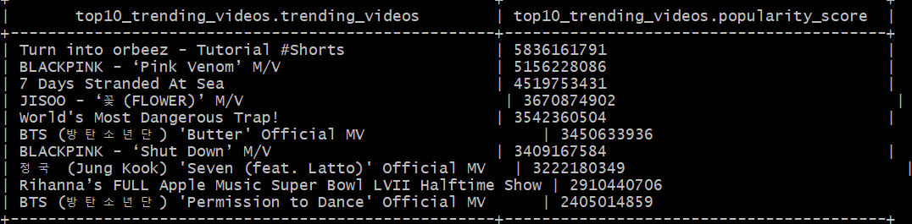
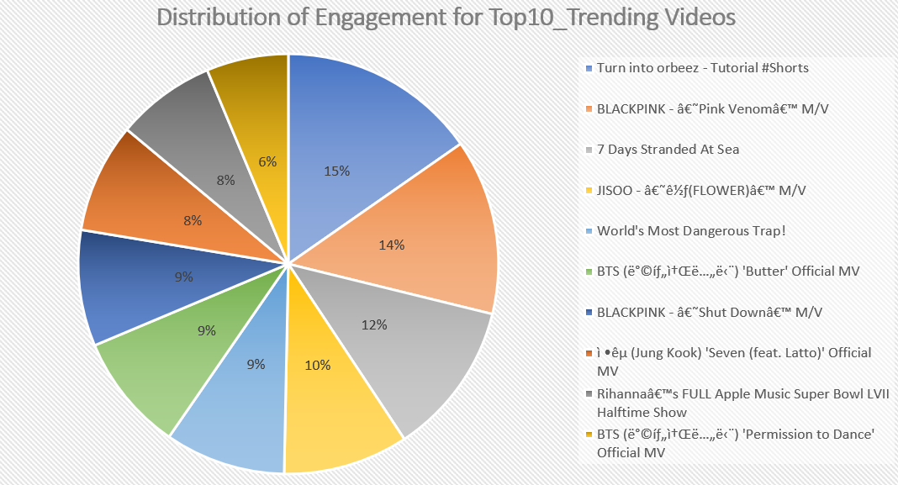
Top-10 Trending Videos Worldwide
Most Trending video from all 7 countries turned out to be ‘Turn into Orbeez – Tutorial’.
Trending videos are scored based on total engagement including factors like views, likes, dislikes, and comments.
Most of the trending videos are originated from South Korea, such as
BTS - 15%
BLACKPINK- 23%
JISOO & JUNK KOOK-18%

Slide 9
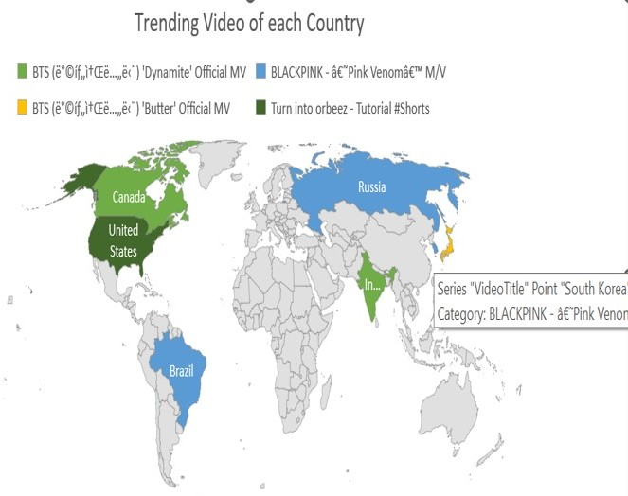
Trending Video of Each country
South Korea, Russia & Brazil:
‘BLACKPINK- Pink Venom’
Canada & India:
‘BTS- Dynamite Official MV’
USA: ‘Turn into Orbeez #Shorts’
Japan: ‘BTS- Butter Official MV’
Showing the fact that, in the last few years viewers’ preferences have changed predominantly.
Choices are not limited to their own geographical level but extended globally irrespective of the origin of videos.
The world is now more connected in terms of entertainment, likes, and dislikes and language is not coming out as a barrier.

Slide 10

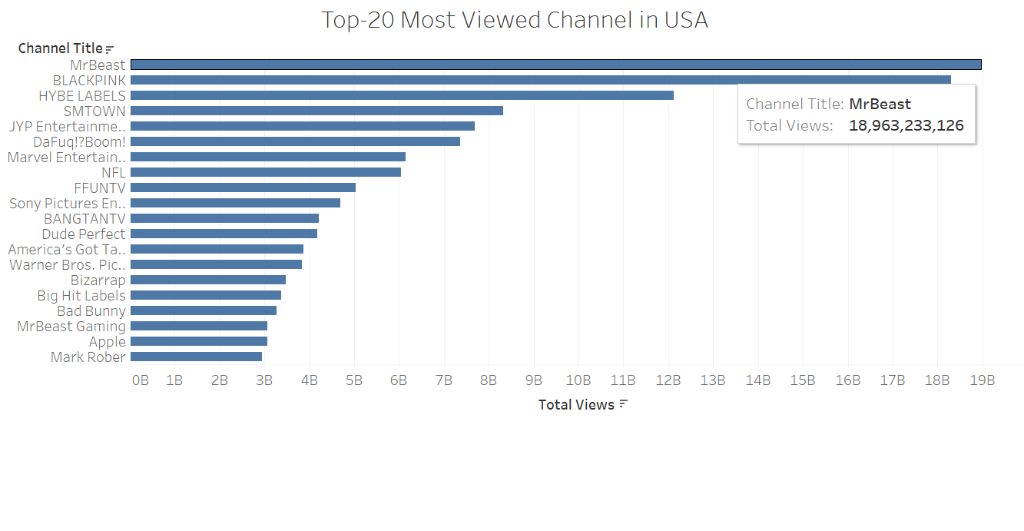
Top-20 MOST VIEWED channels IN the USA
By considering all data from 2020-2023, ‘ MrBeast’ has come out to be the most popular YouTube channel in terms of maximum views (approx. 18.9 billion), it received in the USA.
The top 20 most viewed ranges from almost 3B to 19B shows the vast popularity of these channels among the US 0.33B people so any single channel has been watched many times by US viewers.

Slide 11
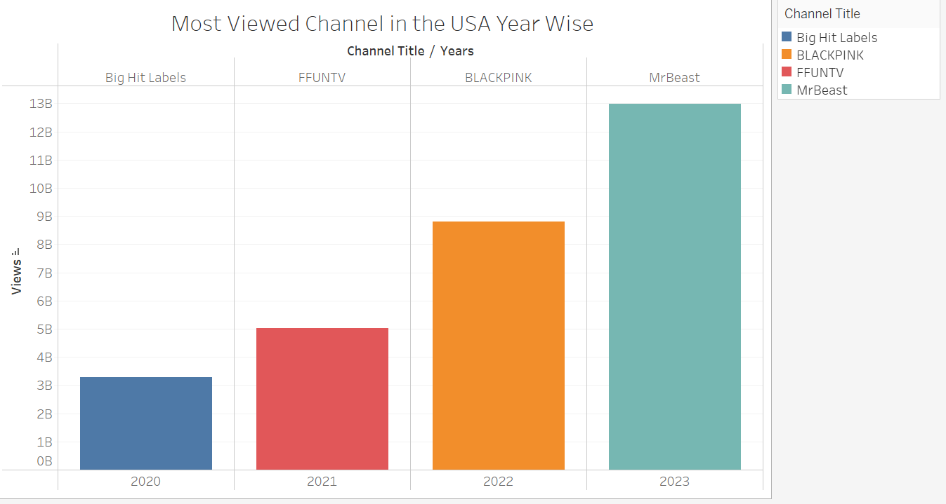
Top VIEWED channels IN the USA YEAR WISE
In USA, from 2020-2023, different channels stand out in popularity.
Number of viewers hikes significantly in every year on their most preferential channel.
(approx. 3B – 13B)
YouTube successfully attracts more audiences in last 4 –years, help them to grow their business as well as other businesses which rely on YouTube through advertisement.

Slide 12
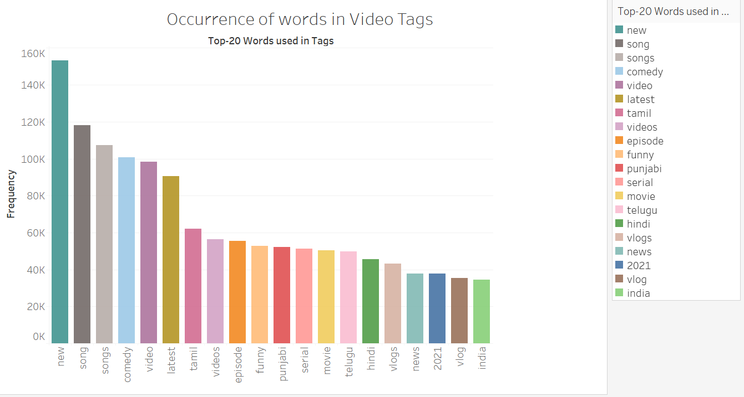
Most SEARCHEd words AS Video Tags IN INDIA
Looking out the repetitive words that has been searched through out the duration in INDIA i.e. NEW, SONG, COMEDY etc.
Indicates people inclination towards their entertainment preferences..
NEW – Looking for more latest available or introduced items.
SONG – How vastly music videos are preferred as one of the top choices.
COMEDY – kind of genre that most people get entertained with, to feel relaxed from daily modern stressful life.

Slide 13
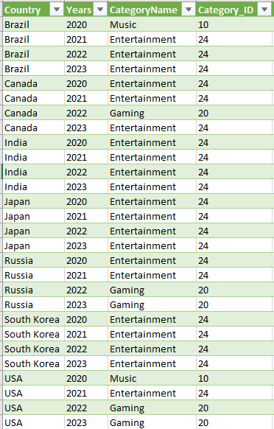
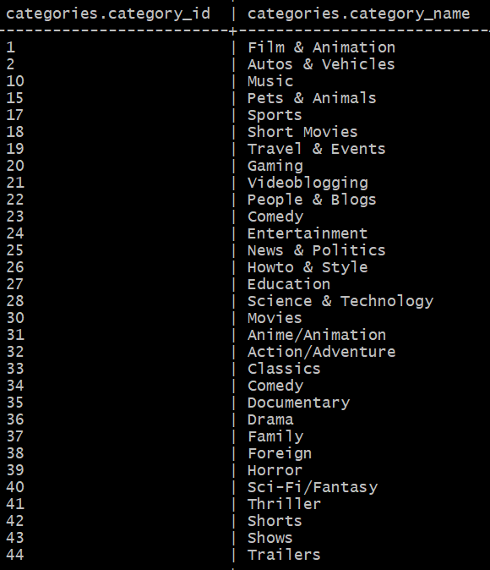
Most watched Category of Videos in each country Year WISE(2020-2023)
Category analysis gives opportunities to examine deep sentiments of what genre of videos are preferable the most.
Entertainment, Gaming & Music are the among top choices in all the years and with all countries.
Entertainment category includes videos related to awards shows, cooking shows, movie reviews, celebrity interviews etc.
This data would help to estimate future trends.
YouTube creators could change their contents as per viewers preferences.
More varieties of videos will be available in popular categories to viewers in future.

Slide 14
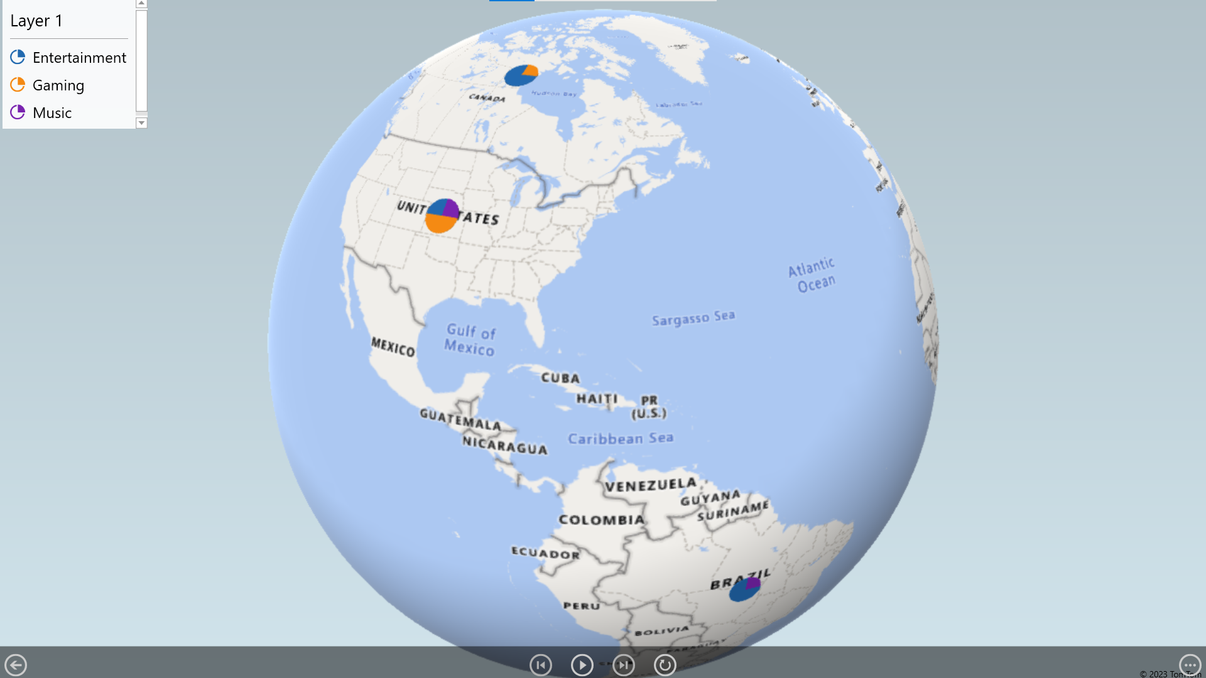
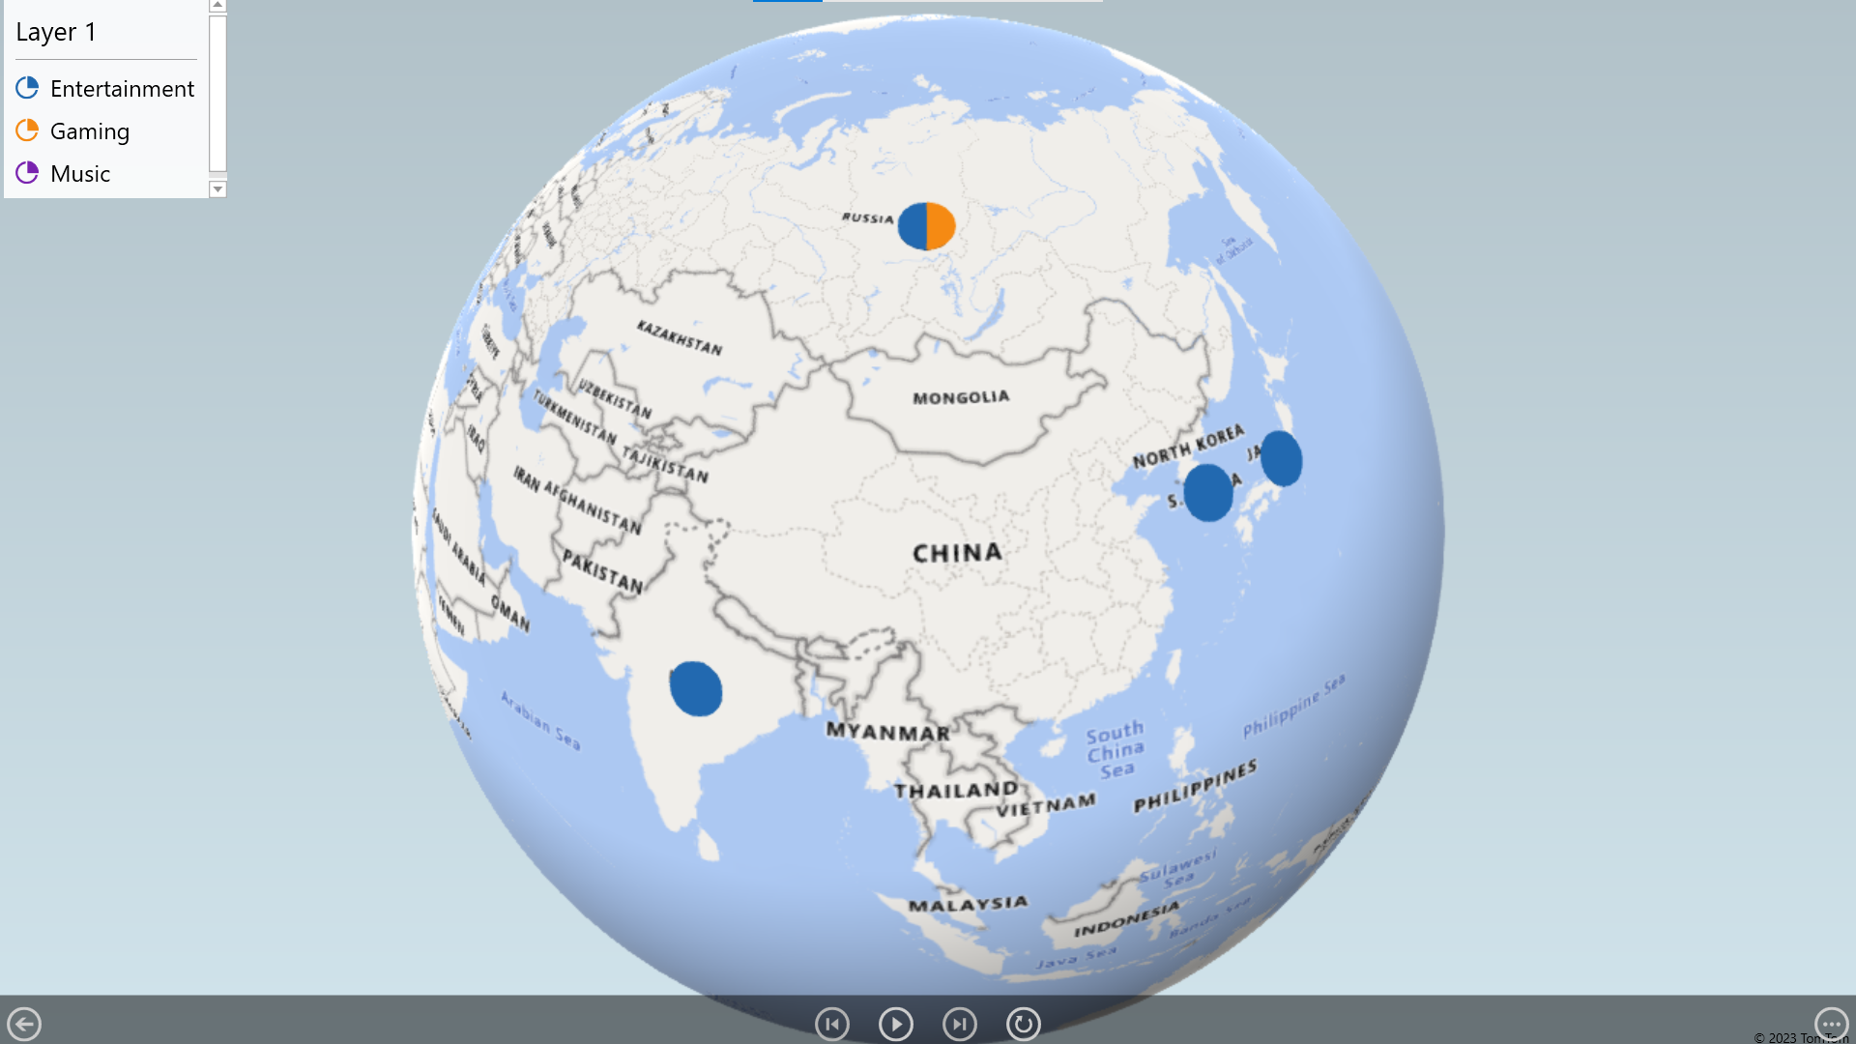
Category year wise analysis

Slide 15

CONCLUSION
By measuring, analyzing and comparing dataset, this statistics gives valuable insights about viewers behavior and certain patterns.
Youtubers can emphasis on the aspects like using certain tags, titles, thumbnails, category of videos, encouraging audience to like, subscribe, share and comment their videos to raise the overall performance.
YouTube can develop better algorithm to process videos by using this findings.
Viewers get better awareness of global trend and make use of it for their own interests.

Slide 16

Thank you
Project Link:
https://github.com/ssarkar4/YouTube_TrendingVideos_DataSet

